Slide 1
Network : Wide Area Networks
Jae Hyeon Kim

Slide 2
Reference
William Stalling, Data and Computer Communications 10/E, Prentice Hall

Slide 3
WAN Technology and Protocols
Switched communications networks
Switching nodes : provide a switching facility that move data between nodes
Stations : devices attached to the network
Nodes : switching devices that provide communication
Communications network : collection of nodes
Switched network : data entering the network from a station are routed to the destination by being switched from node to node

Slide 4
Circuit Switching
Uses a dedicated path between two stations
Has three phases
Establish
Transfer
disconnect
Inefficient
Channel capacity dedicated for duration of connection
If no data, capacity wasted
Set up (connection) takes time
Once connected, transfer is transparent

Slide 5
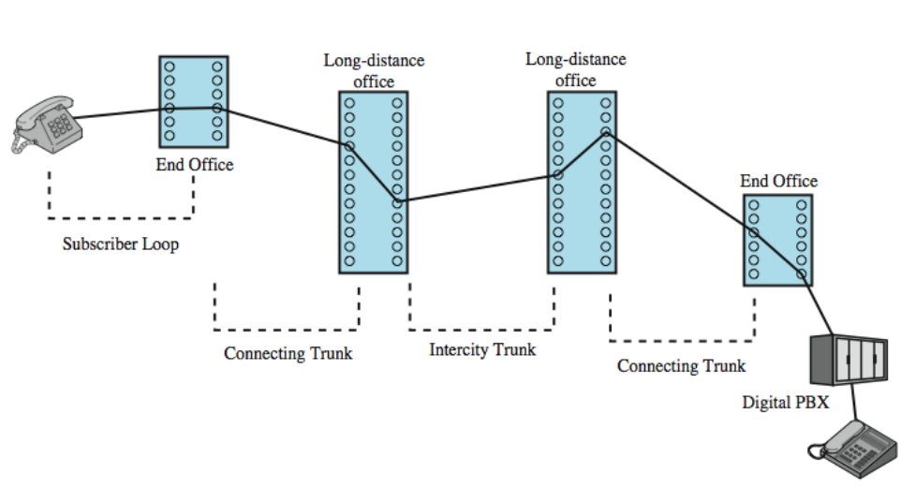
Public Circuit Switched Network

Slide 6
Circuit-Switching Technology
Driven by application that handle voice traffic
Key requirements is no transmission delay and no variation in delay
Efficient for analog trans. Of voice signals but, inefficient for digital trans.
Transparent
Once a circuit is established, it appears as a direct connection no special logic is needed
Telecommunication components
Subscriber : devices attached to network
Local loop : subscriber loop
Exchange : switching centers
Trunks : branched between exchanges

Slide 7
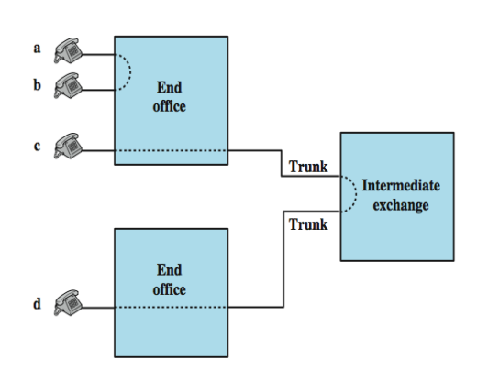
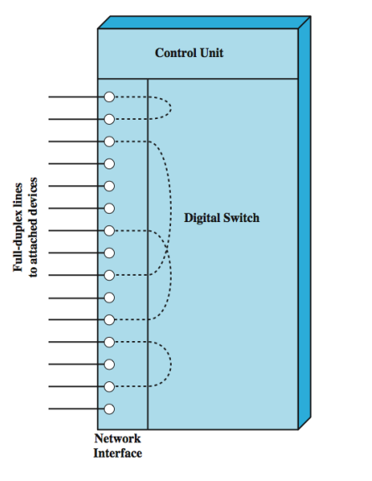
Circuit Switch Elements
Circuit establishment
Circuit switch elements

Slide 8
Blocking or Non-blocking
Blocking network
May be unable to connect stations because all paths are in use
Used on voice systems because it is expected to be of short duration and that a fraction of the phoned will be engaged at any one time
Non-blocking network
Permits all stations to connect at once
Grants all possible connection requests as long as the called party is free
On using data connections, terminals can be continuously connected for long periods of time so nonblocking configurations are required

Slide 9
Space Division Switching
Originally developed for analog environment
Signal paths are physically separate from one another
Crossbar switch
Number of crosspoints grows as square of number of stations
Loss of crosspoint prevents connection
Inefficient : all stations connected, only a few crosspoints in use
Multistage switch
Reduced number of crosspoints
More than one path through network, so increased reliability
More complex control
May be blocking

Slide 10
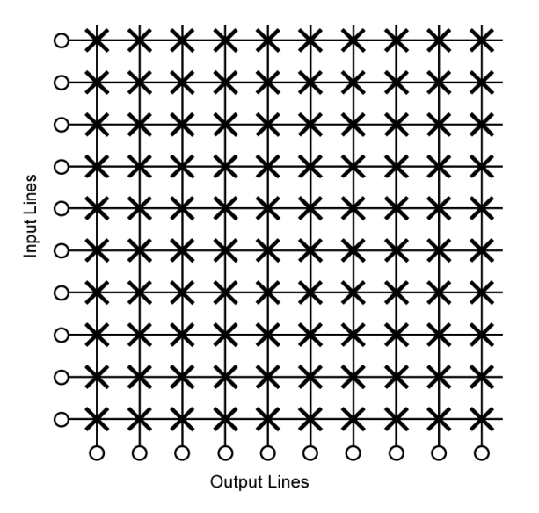
Crossbar Matrix

Slide 11
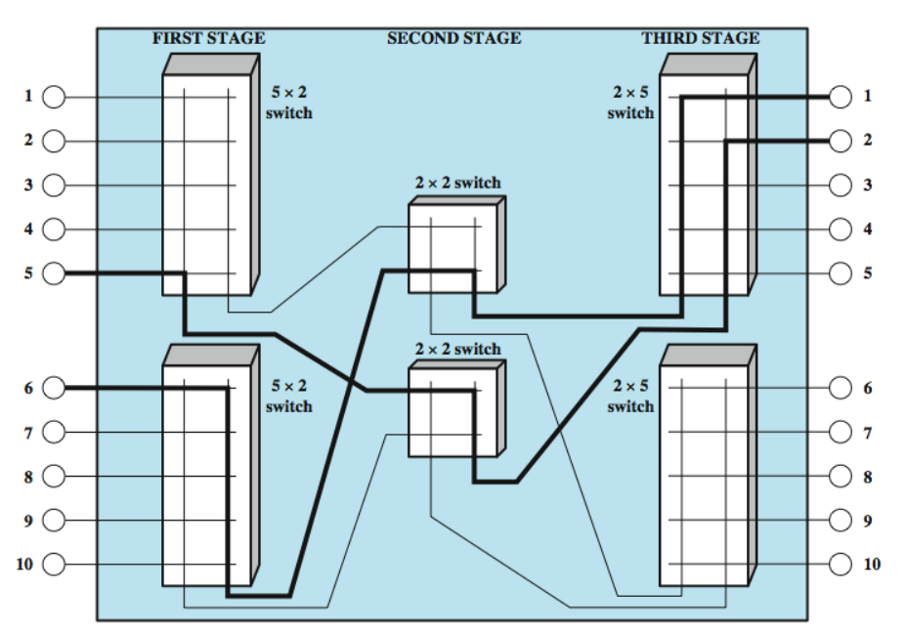
Three Stage Space-Division Switch

Slide 12
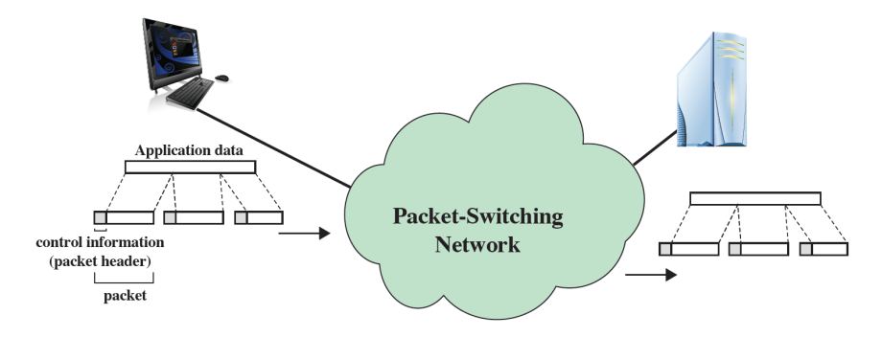
Packet Switching
While circuit switching was designed for voice, packet switching was designed for data
Transmitted in small packets
Packets contains user data and control information
Packets are received, stored and past on to the next node

Slide 13
Advantages
Line efficiency
Single link is shared by many packets over time
Packets queues and transmitted as fast as possible
Data rate conversion
Each station connects to the local node at proper speed
Nodes buffer data if required to equalize rates
No blocking of calls
Packets are accepted even when network is busy
Delivery may slow down – delivery delay increases
Priorities can be used

Slide 14
Switching Technique
Station breaks long message into packets
Packets sent one at a time to the network
Packets handled in two ways
Datagram : each packet is treated independently with no reference to previous packets
Virtual circuit : a preplanned route is established before any packets are sent

Slide 15
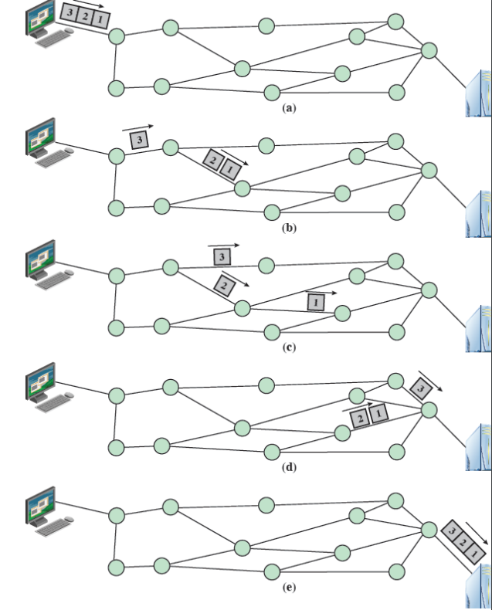
Datagram Approach

Slide 16
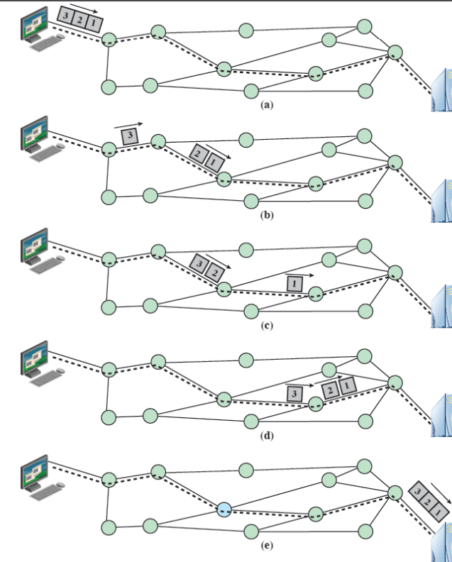
Virtual Circuit Approach

Slide 17
Virtual Circuits vs. Datagram
Virtual circuits
Network can provide sequencing and error control
Packets are forwarded more quickly (no routing decisions to make)
Less reliable (failure of a node lose all circuits through that node)
Datagram
No call setup phase (better if few packets)
More flexible (routing can be used to avoid congested parts of the network)
More reliable (if a node fails, find an alternate route)

Slide 18
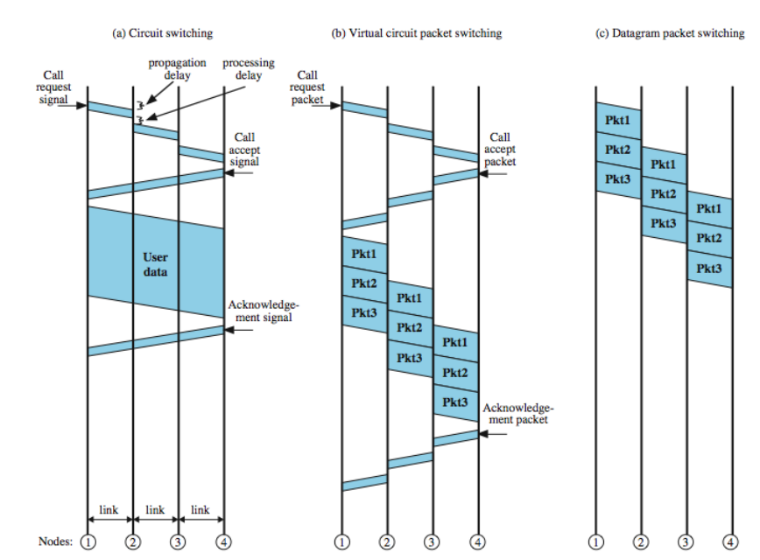
Event Timing

Slide 19
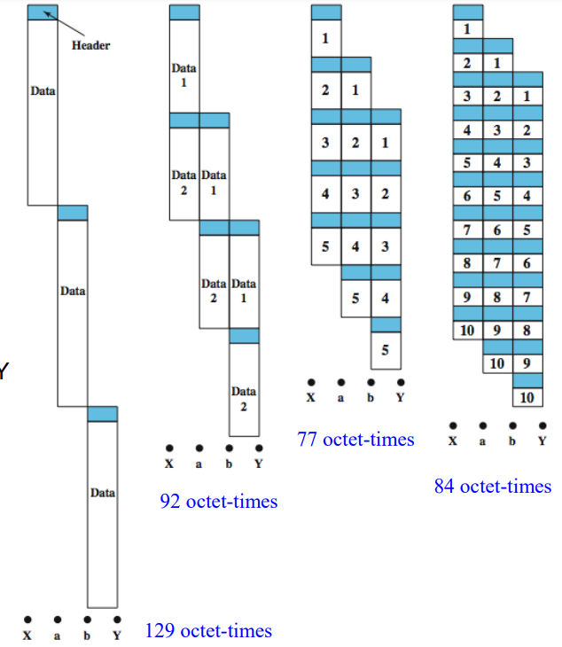
Effect of Packet Size
There is a significant relationship between packet size and transmission time
data pass through X to Y,
packet size 43 octets (40 data, 3 control)

